Slide 1
Data Acquisition System
Chapter 7

Slide 2
Data Acquisition System (DAS)
Data acquisition system (DAS) is an electronic system that measures and collect data from measurement system, covert them in desired form, stores data for future retrieval
Basically measure and record the signals from direct measurement of electrical quantities such as dc and ac voltages, frequency, resistance etc. or signals originating from transducers
DAS must acquire the necessary data at correct speed at the correct time
Must use all data efficiency for proper information
Monitoring features
Provide effective communication system
Able to collect, manipulate and store data properly
Reliable, flexible, expandable
2

Slide 3
Data Acquisition
The process of collecting the input information as rapidly, accurately, economically and completely as necessary.
A typical data acquisition system consists of individual sensors with the necessary signal conditioning, data conversion, data processing, multiplexing, data handling and associated transmission, storage and display systems.

Slide 4
Data Acquisition System
DAS is used to measure and record signals obtained in basically two ways:
  Signal originating from direct measurement of electrical quantities which may include DC and AC voltage, frequency or resistance.
  Signal originating from transducers.

Slide 5
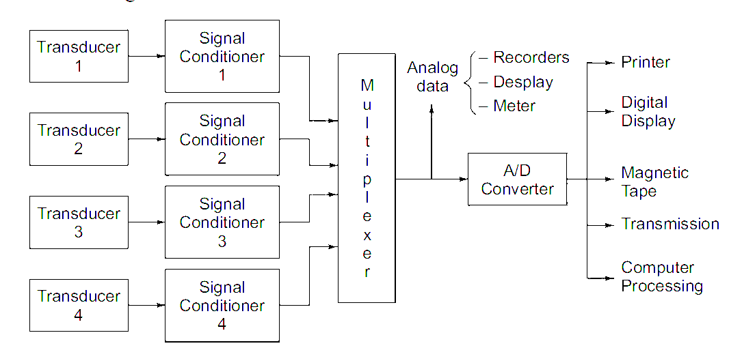
Data Acquisition System

Slide 6
Configuration of DAS
Factors affecting the configuration of DAS:
  Resolution and accuracy
  Number of channels to be monitored.
  Sampling rate per channel.
  Signal conditioner requirement per channel.
  Cost.
Two configurations:
  Single channel DAS
  Multi channel DAS

Slide 7
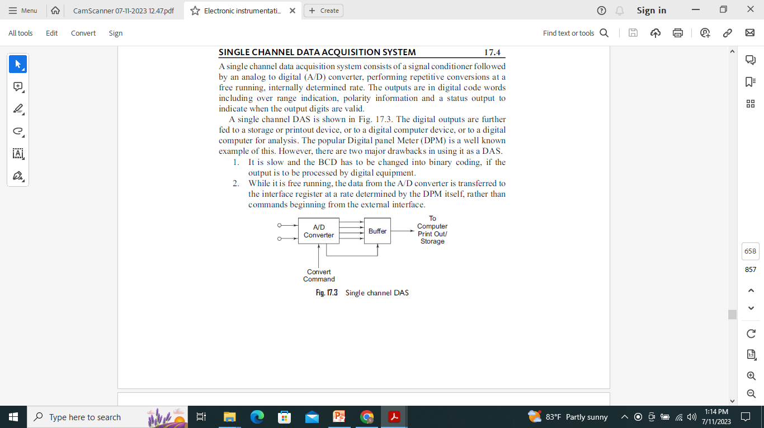
Single Channel DAS
It consists of signal conditioner followed by ADC.
Eg: Digital Panel Meter (DPM)
It is slow and BCD o/p must be converted to Binary if processed by digital equipments.

Slide 8
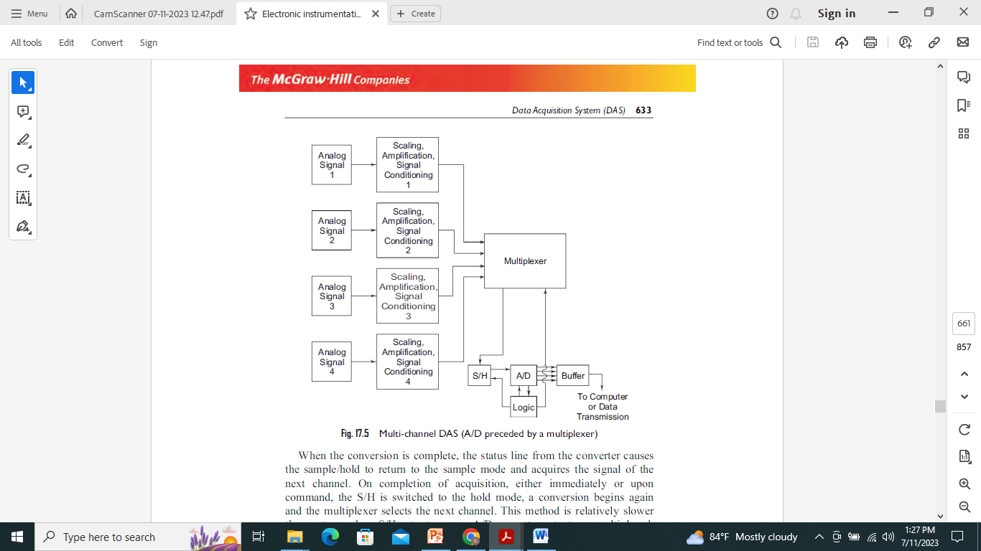
Multi Channel DAS
Individual analog signal applied to MUX thru signal conditioner.
Converted to digital form by ADC sequentially.
To make it more faster, the multiplexer takes the i/p thru next channel while the previous data stored in sample and hold ckt is converted into digital.
When conversion completed, S/H ckt returns to sample mode and acquires the signal of next channel.

Slide 9
Data Acquisition System
As instrument may be either analog or digital systems, correspondingly we have two types of DAS:
  Analog Data Acquisition System
  Digital Data Acquisition System

Slide 10
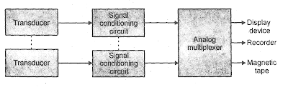
Analog DAS
The block diagram of analog DAS:
Components: Transducer, Signal Conditioner, Analog Multiplexer and Analog Recorders.

Slide 11
Analog DAS
Transducer 1
Signal Conditioner 1
Physical Quantities
Transducer 2
Signal Conditioner 2
Analog Recorder
Multiplexer
Analog Display
Transducer n
Signal Conditioner n
Fig: Block diagram of analog DAS
11

Slide 12
Analog DAS
Transducer translates physical parameters to electrical signals acceptable by the acquisition system. The physical parameters include temperature, pressure, acceleration, weight, displacement, velocity etc.
Electrical quantities such as voltage, resistance, and frequency may be measured directly.
Signal conditioner includes the supporting circuitry for the transducer which provide excitation power, balancing circuits, calibration elements, Amplifying, filtering etc.
Scanner or multiplexer accepts multiple analog inputs and sequentially connects them to one measuring instrument.
Finally measured data is sent to analog recorder for future retrieval or to
analog display
12

Slide 13
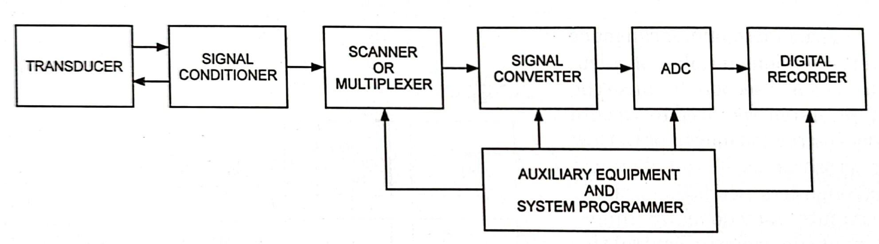
Digital DAS
The block diagram of digital DAS is :

Slide 14
Digital DAS
Transducer 1
Signal Conditioner 1
Digital Recorder
Physical Quantities
Digital Display
Transducer 2
Signal Conditioner 2
Signal Convertor
Multiplexer
ADC
Data Communication
Auxiliary Equipment and
System Programmer
Data Processing
Transducer
n
Signal Conditioner n
Fig: Block diagram of Digital DAS
14

Slide 15
Digital DAS
Signal Converter converts the analog signal to a form acceptable by the ADC. (e.g. amplifier for amplifying low voltage measured by transducer)
Analog to digital convertor (ADC) converts the analog voltage to its equivalent digital form.
The output of the ADC may displayed visually and is also available as voltage outputs in discrete steps for further processing or recording on a digital recorder.
Auxiliary section contains instruments for system programming and digital data processing such as linearizing and limit comparison etc. These functions may be performed by individual instruments or by a digital computer.
15

Slide 16
Digital DAS
Mainly, the following operations take place in digital data acquisition.
  Acquisition of analog signals.
  Conversion of analog signals into digital signals or digital data.
  Processing of digital signals or digital data.
Components:
  Transducer, signal conditioner, MUX, ADC, digital recorder.

Slide 17
Applications of DAS
Biomedical, aerospace, telemetry.
Analog DAS is used when wide bandwidth is required or when lower accuracy can be tolerated.
Digital DAS is used when there is narrow bandwidth, high accuracy and low per channel cost is required.
The complexity of digital DAS range from single channel DC voltage measuring and recording to automatic multi channel system which measures a large parameters, compare them and provide decision.
Digital DAS is more complex than analog DAS in both instruments involved and volume and complexity of i/p data they can handle.

Slide 18
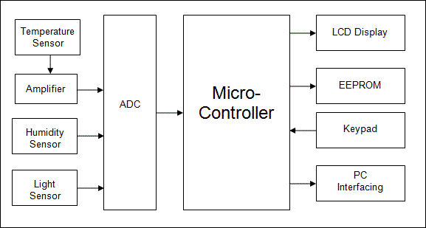
Modern trends in DAS
Microcontroller based DAS

Slide 19
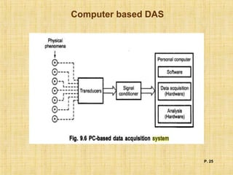
Modern trends in DAS
PC based DAS:

Slide 20
Data Transmission and Telemetry
In modern measurement systems, the various components comprising the system are usually located at a distance from each other. It, therefore, becomes necessary to transmit the data or an information between them through some form of communication channels.
The terms data transmission and telemetry refer to the process by which information regarding the quantity being measured, may be using a transducer and signal conditioning equipment, is transferred to a remote location, perhaps to be processed, recorded and displayed. Telemetry is the technology which enables a user to collect data from several measurement points at inaccessible or inconvenient locations, transmit that data to a convenient location, and present the several individual measurements in a usable form.

Slide 21
METHODS OF DATA TRANSMISSION
The transmission of a measured variable to a remote point is an important function in Instrumentation systems because of the size and complexity of modern industrial plants. The most common variables encountered in industrial plants are temperature, pressure and flow. Most measuring devices for these variables such as mercury thermometers, pressure gauges or flow rate meters would require fluid-line connections of great length from the place of measurement to the place of data recording or display. This will result into excessive measurement lags. Hence, there is a need for fast transmission of data.
The methods employed for data transmission depend upon the variable and the distance over which it has to be transmitted. The following methods may be used for data transmission :
Hydraulic transmission,
Pneumatic transmission, and
Electrical and Electronic transmission.
The electrical and electronic methods of data transmission are extensively used in Instrumentation and measurement systems.

Slide 22
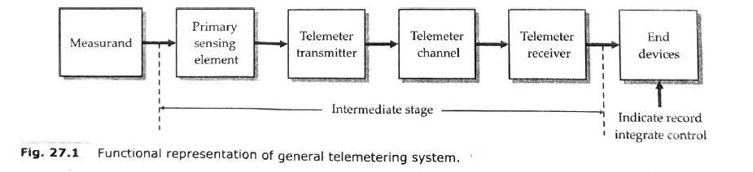
GENERAL TELEMETRY SYSTEM
Telemetry may be defined as measurement at a distance. A general telemetering system is shown in Fig. 27.1. The primary detector and the end device of the telemetering system have the same position and functional roles as in a generalized measurement system. However, there are three system elements in the intermediate stage which are peculiar to a telemetering system, they are :
telemeter transmitter,
telemeter channel,
telemeter receiver.

Slide 23
The function of the telemeter transmitter is to convert the output of a primary sensing element into an electrical signal and to transmit it over a telemetering channel.
This signal is in electrical format and is received by a receiver placed at a remote location.
This signal is converted into a usable form by the receiver and is indicated or recorded by an end device, which is graduated in terms of the measurand.
The end device may be a control element which may be used for the control of the input quantity (measurand), through a feedback loop to produce desired output.

Slide 24
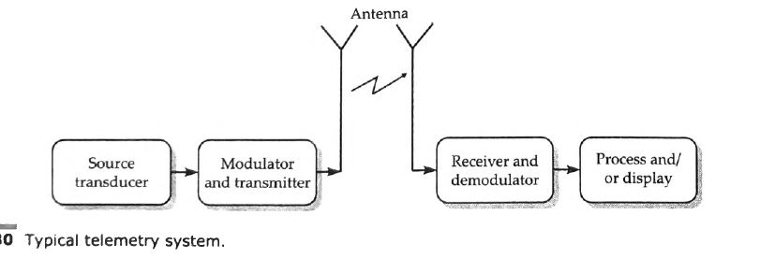
TELEMETRY SCIENCE
Telemetry is the science involved in performing a measurement at a remote location and transmitting
the data to a central location for processing and/or storage. Three basic parts comprise the typical telemetry system (Fig. 27.30) : (1) the data source, which is usually a transducer that converts the measured parameter into an electrical signal ; (2) the mode of transmission of the data ; (3) the receiving station and the recovery of the transmitted data.

Slide 25
TYPES OF TELEMETRY SYSTEMS
Two types of telemetering systems are used :
Land line telemetry,
R.F. (radio frequency) telemetry.
1. LAND LINE TELEMETERING SYSTEM
A land line telemetring system requires a telemeter channel which is a physical link between the telemeter transmitter and receiver. This physical link may be a cable, a specially laid out wire, existing telephone and telegraph cables or a power line carrier.
The land line telemetering is, in fact, a direct transmission of information through cables and transmission lines. The direct transmission via cables employs current, voltage, frequency, position or impulses to convey the information.
Current, voltage and position type systems can be used only for short distances while for long distance telemetry, pulse and frequency types of systems are used.
The information may be in the form of analog or digital signals. While current, voltage, position, frequency and pulse types of signals can be used for analog telemetry, only pulse signals can be used for digital telemetry.

Slide 26
The land line telemetry systems can be classified as :
voltage telemetering systems,
current telemetering systems, and
position telemetering systems.
Voltage Telemetering Systems
A voltage telemetering system transmits the measured variable as a function of an a.c. or d.c. voltage.
Current Telemetering System
A current telemetering system transmits the measured variable as a function of an a.c. or d.c. current.
Position Telemetering System
A position telemetering system transmits and reproduces the measured variable by positioning variable resistors or other electrical components in a bridge circuit form so as to produce proportional changes at both the transmitter and receiver ends.

Slide 27
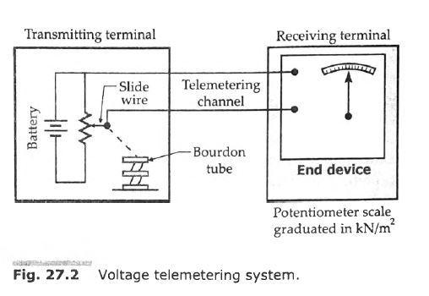

Slide 28
In the land line telemetry, the two primary considerations are :
economy and (ii) reliability.
In the land-line telemetry, the greatest advantage is the simplicity of the set-up as space required and weight are generally of no consideration.
However, the disadvantages are :
all the transmission link distortions are directly introduced into the system. This is particularly true of induction effects of mains frequency from nearby cables.
the effects of thermo-electric emfs may be substantial in case d.c. telemetry systems are used.
(iii) the frequency response is limited.
(iu) signal multiplexing tends to be impracticable.

Slide 29
2. RADIO FREQUENCY (R.F.) TELEMETRY
The telemetry, earlier on, has been defined, as a technology that enables the user to collect data from several measurement points at inaccessible or inconvenient locations. This is very true of applications which require Radio Frequency (R.F.) telemetry, as in such applications, there is no physical link between the transmitting and receiving stations. The link between the transmission station (where the actual measurements are being carried out) and the receiving station (where the measurand is measured, recorded and information used for control purposes) can only be established through radio links.
For example, an aircraft on a test flight has many parameters which change during the flight i.e., fuel flow, amount of fuel, engine performance, vibrations of critical parts, performance of avionic systems, temperature of various components. The test pilot can monitor some of these, of course, by observing the readings of the meters on the panel, but time permits reading those instruments which are critical to the safety of the flight and even those are not sufficiently accurate for detailed flight analysis.

Slide 30
An alternative would be taken along a team of specialist engineers involved in the design, production of the air-craft and analysis of the data produced and to suggest the corrective actions. This solution is just not practicable.
Another, alternative would be to put a sophisticated computer on the flight for analysis of data. This again is not a satisfactory solution.
The best way is to locate the team of engineers on a land based station and the test data be transmitted through radio links from the air-craft to the land station. The team of engineers and the computer stationed on land are in a much better environments to analyse the data and suggest the corrective measures.
R.F. telemetry is usually more suitable if the data is to be transmitted over distances greater than 1 km.

Slide 31
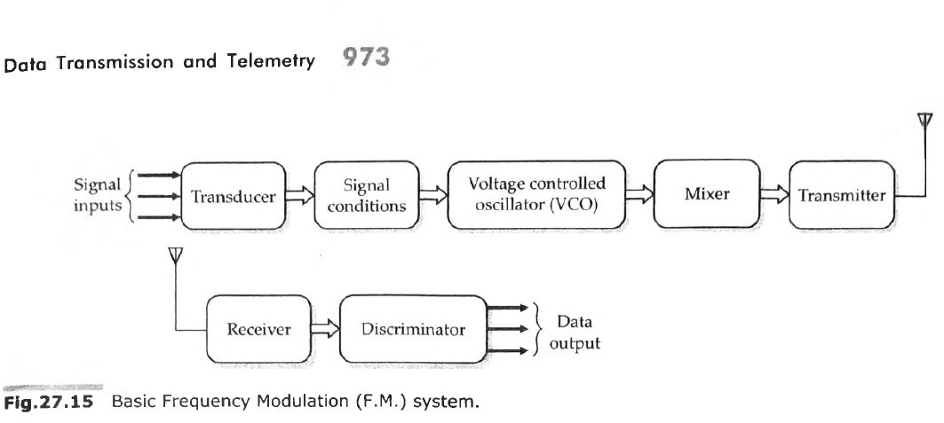

Slide 32
TRANSMISSION CHANNELS AND MEDIA
The most extensively used transmission media are cables and electromagnetic radiation radio links. However, optical, ultrasonic and magnetic induction data links are also used for many applications.
Landline telemetry utilizes cables or wires to transmit data from industrial process plants and power generation stations to central monitoring and control units.
When the data is to be transmitted over lengths greater than 1 km, radio links are usually more suitable. Certain parts of the radio frequency spectrum are allocated for telemetry. The microwave links are used above about 4 MHz. Radio waves at these frequencies tend to travel in a straight line, requiring repeater stations every 30 - 60 km away.
Short range non-contact data links of approximate lengths up to 50 m, such as those used force rotating machinery and power lines generally use either FM radio, optical or ultrasonic methods.

Slide 33
The common communication channels used for telemetering are :
(i) wire line channels
(ii) microwave channels,
(iii) radio channels, and
(iv) power-line carrier channel.
1. Wire Line Channels
For land-line telemetry wire line channels are used. The wire line is the simplest type of channel for transmission of information. The wire lines may be : (a) privately owned or (b) leased from Posts and Telegraphs Department.
For land-line telemetry an enormous variety of connectors are employed. They range from, a pair of open wires, a pair of twisted wires, wires of a telephone cable, to co-axial cables.
2. Radio Channels
Where longer distances are involved, or where measurements have to be made in a missile or moving vehicle, it may be necessary to use radio frequency (RF) techniques to transmit information

Slide 34
3. Microwave Channels
Microwave is a special case of radio transmission.
The necessity for a large number of communication channels in industries like power and gas transmission and the overcrowding of spectrum in the radio frequency range has led to the increased use of microwave radio transmission. Several bands in the range of 890 MHz to 30 GHz have been allocated for microwave transmission.
4. Power Line Carrier Channels
The use of power line carriers has been prevalent for a long time to transmit information between the central generating station and the local substations.
They utilize the power line equipment for this purpose.
An a.c. carrier is coupled to the a.c. voltage transmission line and the information to be telemetered is superposed upon the transmitted power.

Slide 35
Application of Telemetry system
In software development, telemetry systems are used with an end user's permission to remotely monitor the security, health and performance of applications. The information developers get from these systems provides insights into how their applications are performing without the need of feedback from users.
Telemetry is also used in the following fields:
Meteorology. Weather balloons and other meteorological devices use telemetry system to collect and transmit meteorological data such as temperature and barometric pressure.
Agriculture. Wireless weather stations and sensors gather data on the environment, such as temperature, humidity and solar radiation, that helps farmers make decisions about what and when to plant crops.
Space exploration and defense. NASA and the U.S. military use telemetry to monitor the location, performance and health of satellites, spacecraft and aircraft.
Healthcare. Individuals with heart conditions or other medical issues use telemetry devices to monitor heart rate, blood pressure and other vital statistics. This use of telemetry in healthcare is sometimes referred to as biotelemetry.

Slide 36
What is data transmission?
Data transmission refers to the process of transferring data between two or more digital devices. Data is transmitted from one device to another in analog or digital format. Basically, data transmission enables devices or components within devices to speak to each other.
How does data transmission work between digital devices?
Data is transferred in the form of bits between two or more digital devices.
There are two methods used to transmit data between digital devices: serial transmission and parallel transmission.
Serial data transmission sends data bits one after another over a single channel.
Parallel data transmission sends multiple data bits at the same time over multiple channels.

Slide 37
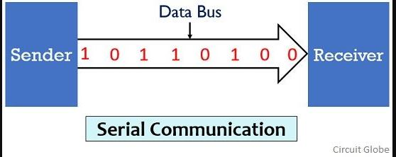
Definition of Serial Communication
In serial communication the data bits are transmitted serially over a common communication link one after the other. Basically it does not allow simultaneous transmission of data because only a single channel is utilized. Thereby allowing sequential transfer rather than simultaneous transfer.
It is highly suitable for long distance signal transmission as only a single wire or bus is used. So, it can be connected between two points that are separated at a large distance with respect to each other. But as only a single data bit is transmitted per clock pulse thus the transmission of data is a quiet time taking process.
The figure below shows the serial data transmission:

Slide 38
Serial transmission has two classifications: asynchronous and synchronous.
Asynchronous Serial Transmission
Data bits can be sent at any point in time. Stop bits and start bits are used between data bytes to synchronize the transmitter and receiver and to ensure that the data is transmitted correctly. The time between sending and receiving data bits is not constant, so gaps are used to provide time between transmissions.
The advantage of using the asynchronous method is that no synchronization is required between the transmitter and receiver devices. It is also a more cost effective method. A disadvantage is that data transmission can be slower, but this is not always the case.
2. Synchronous Serial Transmission
Data bits are transmitted as a continuous stream in time with a master clock. The data transmitter and receiver both operate using a synchronized clock frequency; therefore, start bits, stop bits, and gaps are not used. This means that data moves faster and timing errors are less frequent because the transmitter and receiver time is synced. However, data accuracy is highly dependent on timing being synced correctly between devices. In comparison with asynchronous serial transmission, this method is usually more expensive.

Slide 39
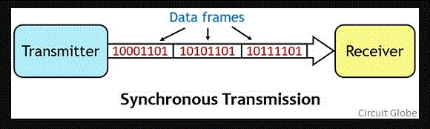
Definition of Synchronous Transmission
Here the name itself is indicating that synchronous transmission needs synchronization between transmitter and receiver in order to allow communication between the two. Basically, despite having internal clock pulses, the transmitter and receiver share a common clock pulse so as to have synchronization in communication. This means data will be transmitted between the transmitter and receiver only after a constant time interval.
The figure below represents the synchronous transmission between the sender and receiver:
It allows the transmission of data in the form of frames or blocks. Thus, a huge data amount can be transmitted between transmitter and receiver once the clock pulse is sent. This time interval is decided by the frequency of the external clock pulse. So basically in synchronous transmission, the clock pulse decides when to transmit the data and for this, both transmitter and receiver must be ready to have communication.

Slide 40
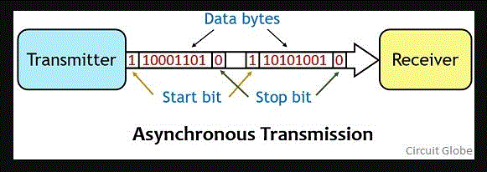
Definition of Asynchronous Transmission
Asynchronous transmission is a type of serial transmission that follows a non-synchronized form of communication. Thus start and stop bits are required in order to intimate the receiver about the beginning and end of the data stream.
The figure below shows the asynchronous transmission technique:

Slide 41
Here the data is transferred from an end to another in the form of bytes or characters. Thus when the transmitter wants to send data then it has to notify the receiver that it is going to send the data bits. So for this reason before sending the actual data the transmitter sends a start bit that notifies the receiver about the transmission.
And after sending the data byte, the transmitter sends stop bit that shows the completion of the data. The transmitter and receiver in the asynchronous transmission system have their internal clock for operation. But do not operate on a common clock pulse.
Thereby leading to unawareness about the proper transmission. Therefore, due to this reason start and stop bits are utilized in the asynchronous communication system. However, the presence of start and stop bit reduces the data transmission rate in the case of asynchronous transmission.

Slide 42
Key Differences Between Synchronous and Asynchronous Transmission
The synchronous transmission allows the transmission of data in frame or block formats. Whereas, in asynchronous transmission, a byte or character is transmitted at a time.
Due to the transmission of data in the form of frames the rate of data transmission is quite fast in synchronous transmission. While in asynchronous transmission the rate of data transmission is comparatively slow.
Synchronous communication needs synchronization between sender and receiver thus the two shares a common clock pulse. On the contrary, Asynchronous communication does not permit synchronized communication and thus the sender and receiver have their own internal clock.
Due to the existence of clock pulse, data in the form of frames can be continuously transmitted between sender and receiver. While the absence of a common clock pulse causes the existence of gaps between data bits.

Slide 43
The synchronous transmission does not require start and stop bits. As against in order to have asynchronous transmission between sender and receiver, start and stop bits are necessarily needed before and after the message signal bits.
The time interval of transmission remains constant between the data to be transmitted. However, in the case of asynchronous transmission variable time intervals between the data bits exist.
A system supporting synchronous transmission is comparatively complex than asynchronous transmission system.
Due to synchronized communication, the synchronous transmission is more efficient compared to asynchronous transmission.
The complexing of the system in synchronous transmission increases the cost of the system. Thus synchronous transmission is more expensive than asynchronous transmission.

Slide 44
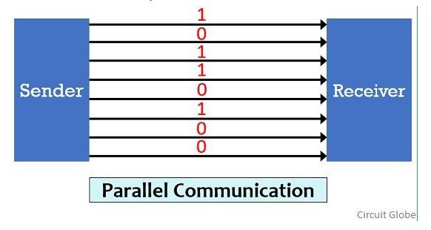
Definition of Parallel Communication
In parallel communication the various data bits are simultaneously transmitted using multiple communication links between sender and receiver. Here, despite using a single channel between sender and receiver, various links are used and each bit of data is transmitted separately over all the communication link.
The figure below shows the transmission of 8 byte data using parallel communication technique:

Slide 45
Here, as we can see that for the transmission of 8-bit of data, 8 separate communication links are utilized.
And so rather following a sequential data transmission, simultaneous transmission of data is allowed. This leads to a faster communication between the sender and receiver.
But for connecting multiple lines between sender and receiver multiple connecting unit are to be present between a pair of sender and receiver.
And this is the reason why parallel communication is not suitable for long distance transmission, because connecting multiple lines to large distances is very difficult and expensive.

Slide 46
Differences Between Serial and Parallel Communication
Due to the presence of single communication link the speed of data transmission is slow. While multiple links in case of parallel communication allows data transmission at comparatively faster rate.
Whenever there exists a need for system up-gradation then upgrading a system that uses serial communication is quite an easy task as compared to upgrading a parallel communication system.
In serial communication, the all data bits are transmitted over a common channel thus proper spacing is required to be maintained in order to avoid interference. While in parallel communication, the utilization of multiple link reduces the chances of interference between the transmitted bits.
Serial communication supports higher bandwidth while parallel communication supports comparatively lower bandwidth.
Serial communication is efficient for high frequency operation. However, parallel communication shows its suitability more in case of low frequency operations.
Due to existence of single link, the problem of crosstalk is not present in serial communication. But multiple links increase the chances of crosstalk in parallel communication.
Serial communication is suitable for long distance transmission of data as against parallel communication is suitable for short distance transmission of data.

Slide 47
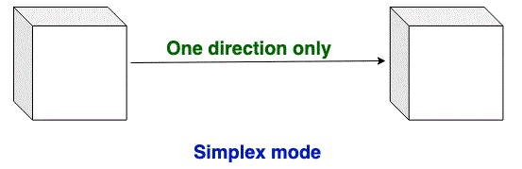
Transmission Modes in Computer Networks
There are 3 types of transmission modes which are given below: Simplex mode, Half duplex mode, and Full-duplex mode.
Simplex mode: In simplex mode, Sender can send the data but the sender can’t receive the data. It is a unidirectional communication.
Half-duplex mode: In half-duplex mode, Sender can send the data and also can receive the data one at a time. It is two-way directional communication but one at a time.
Full duplex mode: In full-duplex mode, Sender can send the data and also can receive the data simultaneously. It is two-way directional communication simultaneously.

Slide 48
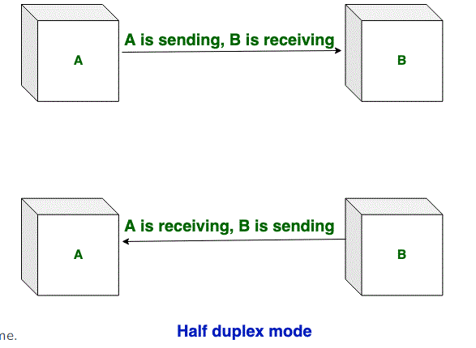
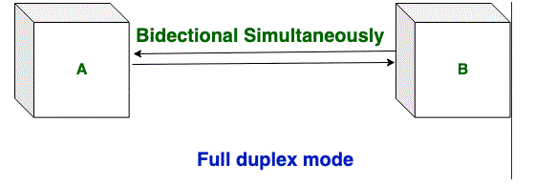

Slide 49
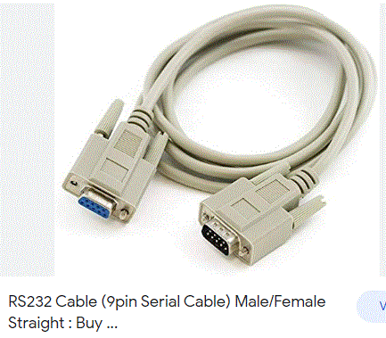
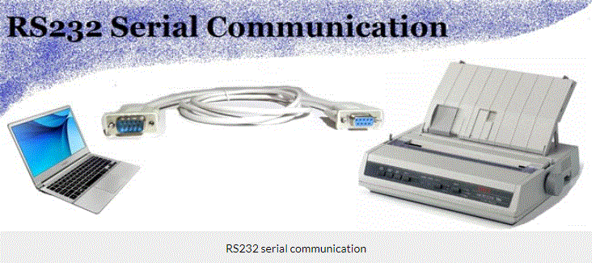
RS 232 cable

Slide 50
Features and application of RS 232 cable
RS232 cables support a typical transmission speed of 9600 bps at 15 m. They provide asynchronous communication capabilities with hardware flow control, software flow control, and parity checking. Most gears, instruments with digital control interfaces, and communication devices have an RS232 interface.
The application may determine the cable's dimensional and electrical specifications, as well as its end connectors and approvals and certifications.
Suppliers offer serial cables for audio / video (A/V), automotive, imaging, medical, radio frequency (RF), and telecommunications applications.
There are also cables for personal computers (PCs), local area network (LAN) and Ethernet applications, and industrial control and instrumentation systems.

Slide 51
Features & Benefits
Best-in-Class Shield Technology: Patented Beldfoil shield technology offers 100% coverage, preventing outside noise from affecting the signal
Multiple Temperature Options: Range of jacket material options suited for different temperature ratings and budget requirements
Longer Transmission Distances: Lower capacitance allows signal transmission over extended distances
Simplified Installation: Cables use finely stranded conductors for increased flexibility
Easy to Spec & Design: Offered in a range of gauge sizes, shielding options, conductor types and pair counts

Slide 52
What is RS232?
RS232C “Recommended Standard 232C” is the recent version of Standard 25 pin whereas, RS232D which is of 22 pins. In new PC’s male D-type which is of 9 pins.
RS232 is a standard protocol used for serial communication, it is used for connecting computer and its peripheral devices to allow serial data exchange between them. As it obtains the voltage for the path used for the data exchange between the devices. It is used in serial communication up to 50 feet with the rate of 1.492kbps. As EIA defines, the RS232 is used for connecting Data Transmission Equipment (DTE) and Data Communication Equipment (DCE).
Universal Asynchronous Data Receiver &Transmitter (UART) used in connection with RS232 for transferring data between printer and computer. The microcontrollers are not able to handle such kind of voltage levels, connectors are connected between RS232 signals. These connectors are known as the DB-9 Connector as a serial port and they are of two type’s Male connector (DTE) & Female connector (DCE).

Slide 53
IEEE 1284
is a standard that defines bi-directional parallel communications between computers and other devices. The IEEE 1284 standard allows for faster throughput and bidirectional data flow with a theoretical maximum throughput of 4 megabytes per second; actual throughput is around 2 megabytes/second depending on hardware.
In the printer venue, this allows for faster printing and back-channel status and management. Since the new standard allowed the peripheral to send large amounts of data back to the host, devices that had previously used SCSI interfaces could be produced at a much lower cost. This included scanners, tape drives, hard disks, computer networks connected directly via parallel interface, network adapters and other devices. No longer was the consumer required to purchase an expensive SCSI card—they could simply use their built-in parallel interface.

Slide 54
Optical communication is any type of communication in which light is used to carry the signal to the remote end, instead of electrical current. Optical communication relies on optical fibers to carry signals to their destinations. A modulator/demodulator, a transmitter/receiver, a light signal and a transparent channel are the building blocks of the optical communications system.

Slide 55
Optical communication systems consist of the following components:
Transmitter: Converts and transmits an electronic signal into a light signal. The most commonly used transmitters are semiconductor devices, such as light-emitting diodes (LEDs) and laser diodes.
Receivers: Typically consist of a photo-detector, which converts light into electricity using the photoelectric effect. The photo detector is typically a semiconductor-based photodiode.
Optical Fiber: Consists of a core, cladding and a buffer through which the cladding guides the light along the core by using total internal reflection.
The main benefits of optical communication include high bandwidth, exceptionally low loss, great transmission range and no electromagnetic interference. The cons of optic communication include the high cost of cable, transmitter/receiver and other support equipment, and the skill and expertise required during cable installation and interconnection.

Slide 56
Functional Advantages
The functional advantages of optical fibers are −
The transmission bandwidth of the fiber optic cables is higher than the metal cables.
The amount of data transmission is higher in fiber optic cables.
The power loss is very low and hence helpful in long-distance transmissions.
Fiber optic cables provide high security and cannot be tapped.
Fiber optic cables are the most secure way for data transmission.
Fiber optic cables are immune to electromagnetic interference.
These are not affected by electrical noise.

Slide 57
Physical Advantages
The physical advantages of fiber optic cables are −
The capacity of these cables is much higher than copper wire cables.
Though the capacity is higher, the size of the cable doesn’t increase like it does in copper wire cabling system.
The space occupied by these cables is much less.
The weight of these FOC cables is much lighter than the copper ones.
Since these cables are di-electric, no spark hazards are present.
These cables are more corrosion resistant than copper cables, as they are bent easily and are flexible.
The raw material for the manufacture of fiber optic cables is glass, which is cheaper than copper.
Fiber optic cables last longer than copper cables.

Slide 58
Disadvantages
Although fiber optics offer many advantages, they have the following drawbacks −
Though fiber optic cables last longer, the installation cost is high.
The number of repeaters are to be increased with distance.
They are fragile if not enclosed in a plastic sheath. Hence, more protection is needed than copper ones.
Applications of Fiber Optics
The optical fibers have many applications. Some of them are as follows −
Used in telephone systems
Used in sub-marine cable networks
Used in data link for computer networks, CATV Systems
Used in CCTV surveillance cameras
Used for connecting fire, police, and other emergency services.
Used in hospitals, schools, and traffic management systems.

Slide 59
Fiber Optic
Fiber optic refers to the technology and medium used in the transmission of data as pulses of light through a strand or fiber medium made of glass or plastic (optical fiber), versus being sent as electrical pulses through conductive metal, like copper wires. Optical fiber technology can carry much more data than conventional copper wires and is less prone to electromagnetic interference, simply because data is transmitted in the form of light, rather than electricity.

Slide 60
Fiber optic technology uses glass fibers to transmit data at blazing fast speeds, although not as fast as the speed of light. This is because the general notion of the speed of light, which is 299,792,458 meters per second, occurs in a vacuum. In reality, the speed at which light travels greatly varies, depending on the medium through which it passes.
To decode data, special hardware with light sensors is needed for each terminal of the fiber optic cable. This technology is considerably more expensive because manufacturing this type of cable is more expensive, and even connecting two ends requires expensive measures.

Slide 61
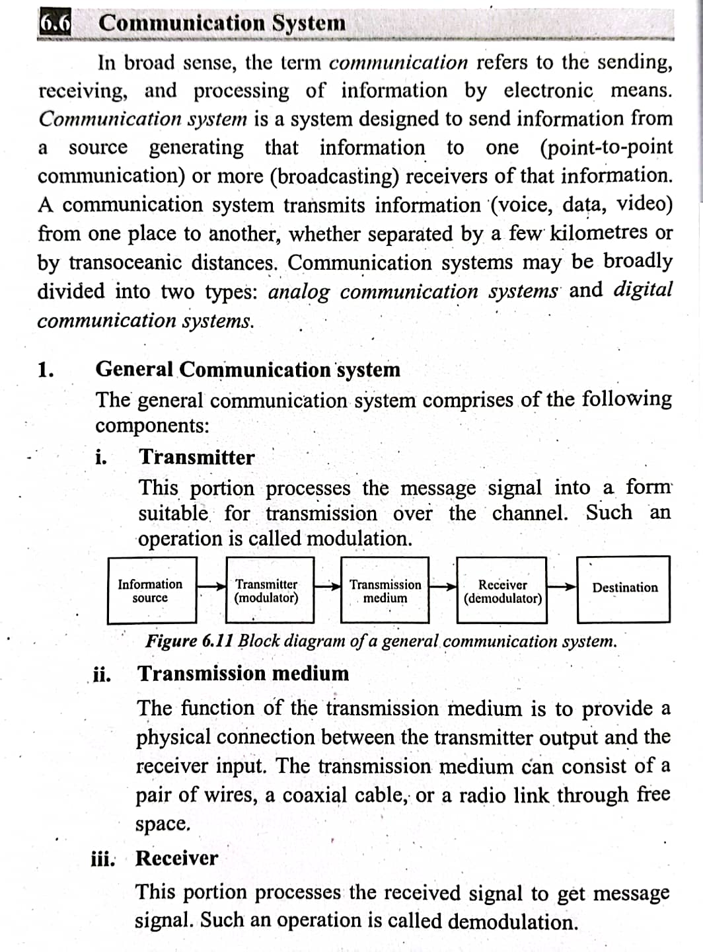

Slide 62
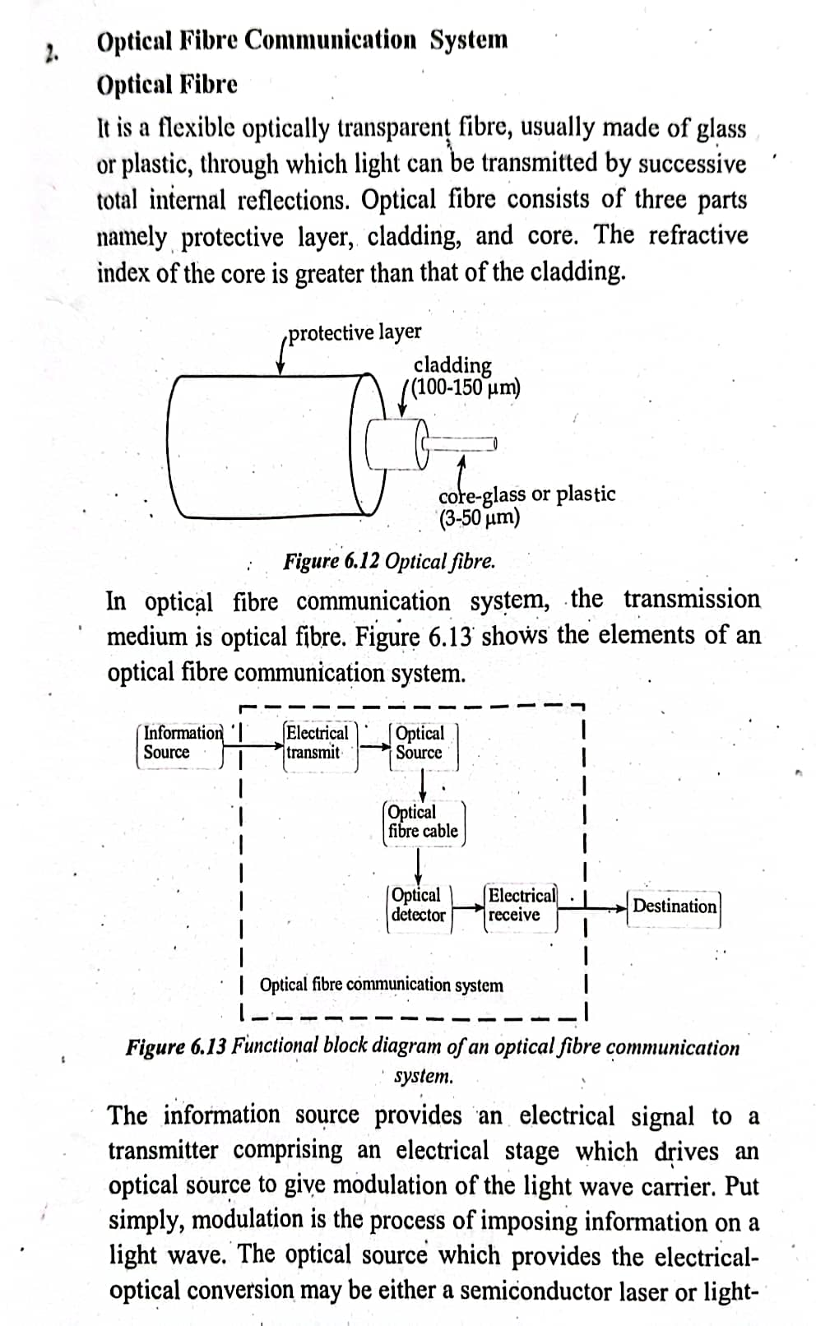

Slide 63
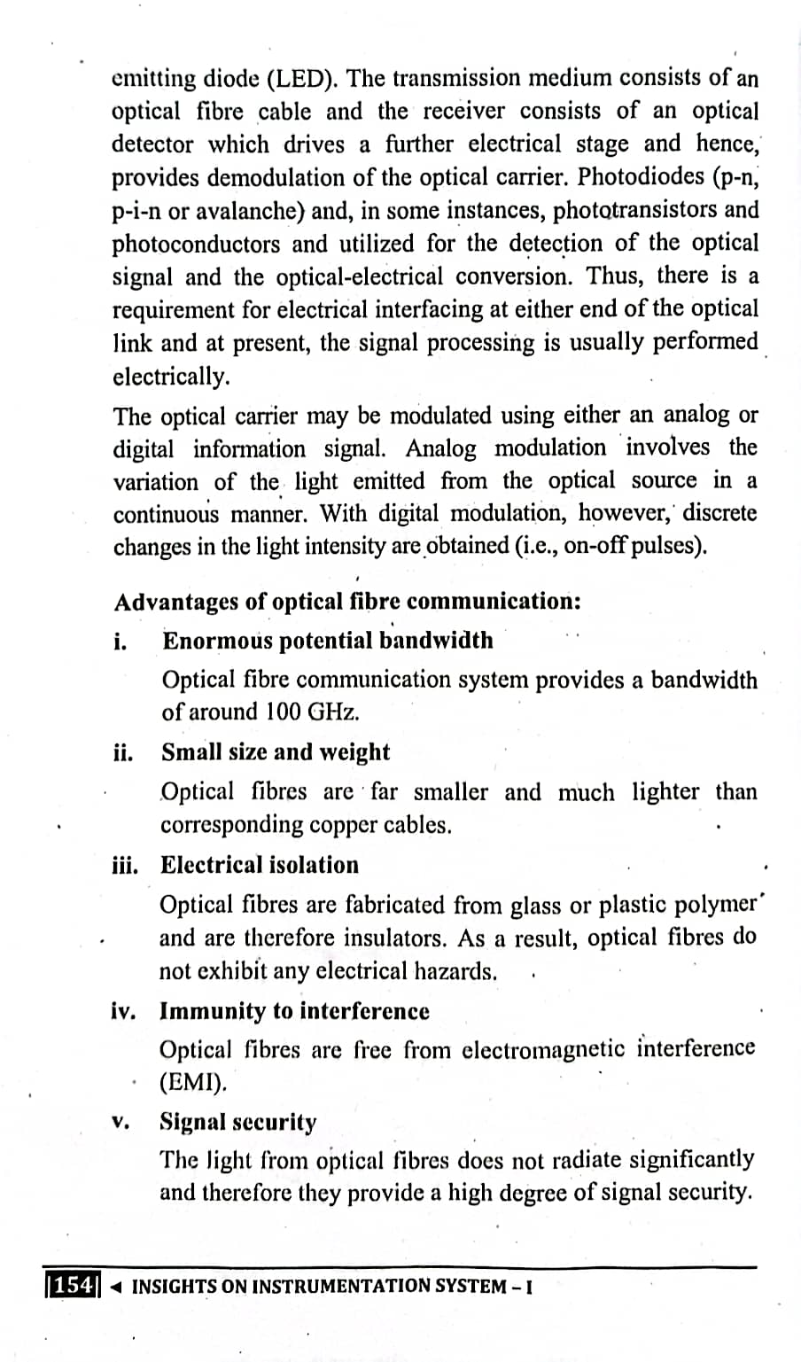

Slide 64
